Slide 1
ECOMMERCE
Heidi Jarvis

Slide 2
EcomMERCE
HEIDI JARVIS

Slide 3
EcomMERCE
Other options
Big Commerce
Square Online
Wix
WooCommerce
Platforms Big Cartel
Basic & low costs
Very easy to use
great for starters or small about products
Shopify
Advanced & higher costs
Easy to integrate with emails, social media
Large range of plugs/apps to add
Provides detailed reporting

Slide 4
ECOMMERCE
Home Page Aims
Communicate why your brand and your products are valuable
Why customers cant live without them
Handle any objections, such as returns, too expensive, quality, can I buy it else where
How
Through testimonials
Special offers – FOMO
Return Policy
Unique Selling Points
Your Unique Story
HEIDI JARVIS

Slide 5
EcomMERCE
Checklist
In the following order:
Discount for first time customers - banner advert and pop up
Menu
Banner showcasing products
Testimonials
Key products you want to sell
Product collections / categories
3 points – Returns, USP
Testimonials
Instagram Feed
Enews sign up
BLOG
Footer – includes Other information such as about us, shipping, returns, FAQs, stockists, contact
Examples
HEIDI JARVIS

Slide 6
EcomMERCE
Pages Checklist
Home & About Page
Category and Product Pages
Blog Posts
Contact Us Page
FAQ Page
Shipping, Returns, & Refund Policy Pages
Terms & Conditions Page
Privacy Policy Page
Finalise Header and Footer Navigation
HEIDI JARVIS

Slide 7
EcomMERCE
BLOG
A great way to implement those frequently-searched keyword phrases into your site
Sets your business up as a thought-leader in your industry
Promote your business’s blog via social media for additional exposure
Engage with Customers and can include in enews & on website
Adds Value to your brand
HEIDI JARVIS

Slide 8
EcomMERCE
Aims
Make sure it is as easy as possible to purchase
Check out is simple
Questions & objections are addressed
Ensure a purchase is made within 2-3 visits
Increase order value - $100+
Life Time Value of Customers
HEIDI JARVIS

Slide 9
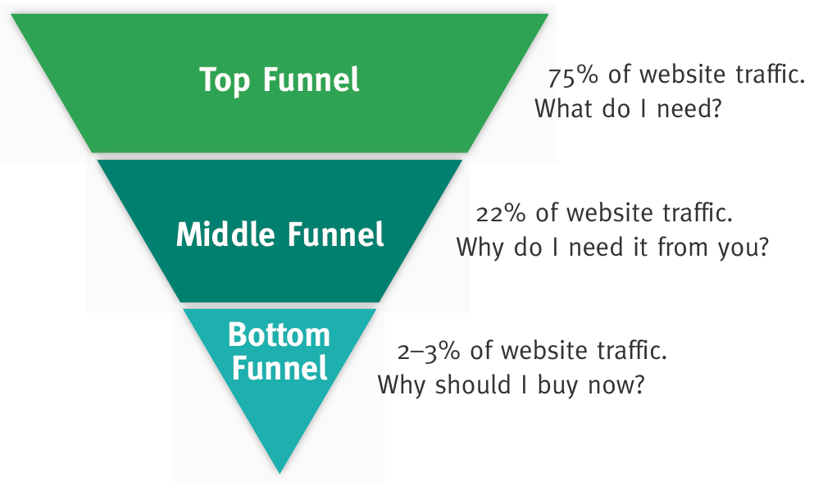
EcomMERCE
Sales Funnels
TOF – new through advertising, search, BLOG or referral. This is where you sell your value why they cant live without your brand, emotional connection
MOF – had some exposure, still hesitant need convincing with different products, more detailed information, UGC, how to use the product
BOF – need motivation, such as discount, sales opportunity, limited time offer, new products or further objection handling
HEIDI JARVIS

Slide 10
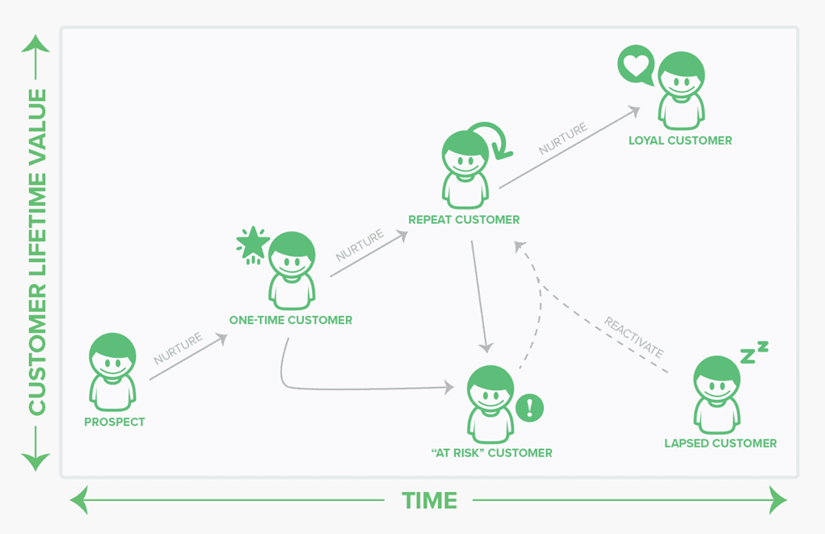
EcomMERCE
Life Time Value
Once you have the customers you want to ensure hold on to them.
Apps to calculate your LTV
Subscribers offers – discounts, new releases, sales, blogs, tips and advice
Rewards Programs - reviews, purchases, referrals, social shares
HEIDI JARVIS

Slide 11
EcomMERCE
Traffic
Advertising - FB, Insta, Google
SEO
Referrals
Links on other’s websites
BLOG
HEIDI JARVIS

Slide 12
EcomMERCE
Integrations & Automation
Social – FB, Insta, Messenger, Google shop
Reviews - feed into the website
Customer Services enquires – chat, emails, social media comments integrates with Shopify and orders
Emails – welcome, abandonment cart, website browse
Accounting – feed everything into Xero
Google Analytics
Facebook Pixel
Payments Gateways – afterpay, paypal, google pay, shop pay
HEIDI JARVIS

Slide 13
EcomMERCE
Recommended Apps
Stamped - Reviews
Stamped Rewards – rewards program
Gorgias - Customer enquiries – chat, emails, social media comments integrates with Shopify and orders
Push Owl – push through special offers, sales
Klaviyo – emails & sms
Back in Stock – create sense of urgency
Gift Wrapping - add to order at a $
HotJar – see customers behavior
Australia Post
Other apps
Use apps/plugins automate and stop repetitive tasks
Products, Digital Products & Ticketing
Sales & Marketing
Conversion
Shipping & Fulfillment
Store management
Examples
HEIDI JARVIS

Slide 14
EcomMERCE
Point of Sale
Depends on the amount of products and inventory setup , if we did we would have something that worked with shopify. We have used a traditional EFTPOS & paypal
Manually enter phone orders
Square
Paypal card reader
HEIDI JARVIS

Slide 15
EcomMERCE
How
Shopify support chat – really helpfully, community forums
Upwork – for graphic designs, customer service, accounting, website development, SEO and FB advertising
HEIDI JARVIS

Slide 16
EcomMERCE
QUESITONS?
HEIDI JARVIS

